Slide 1

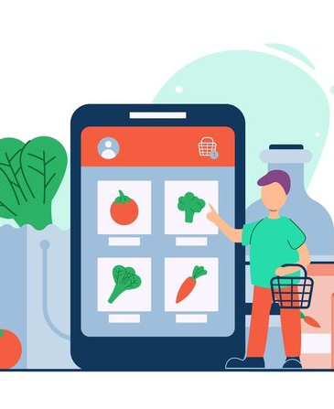
Presenting-
bechaKena
(e-commerce based android application)
Supervised by-
Nazia Jahan Khan Chowdhury
Assistant Professor
Presented by-
Subah Noshin_1907024
Farzana Rahman_1907028
Department of Computer Science and Engineering, KUET

Slide 2

Agenda
Introduction​…………….3
Objectives………….…4
Primary Goal………….…5
System Architecture Design…………….6
Methodology………….…​7-20
Important Features………..……21
​Challenges Faced………….…22
Future Plan………..……23
Conclusion………….…24

Slide 3
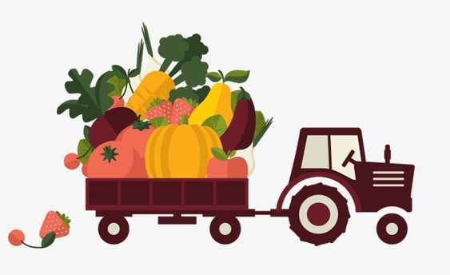
Introduction
‘bechakena’ is an e-commerce based android application that provide the customers full flexibility. It provides-
Online platform where customers can buy their grocery items.
The advantage to the customers to know about what grocery items are currently available, the price of the items, the discounts available to the items and know about the popular grocery items.
The choice of options for customers to choose any payment method (cash on delivery/bkash).
A faster solution than going to the grocery shops.

Slide 4
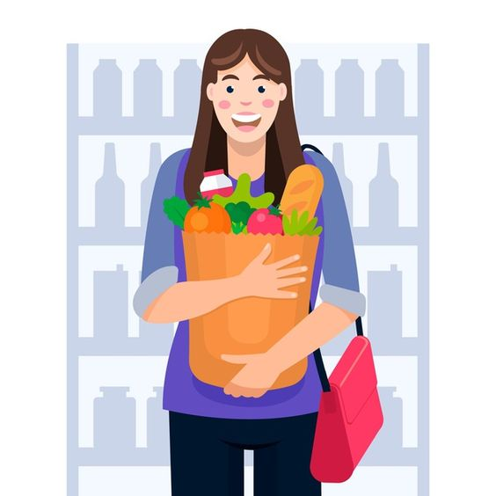
objectives
Our application helps the customers in many ways. Our objectives are -
To help customers to know about currently available grocery items
To help customers to buy grocery items quickly
To ensure faster service to the customers
To save the valuable time of customers
To help the customers to know about the deliveryman
To provide both offline and online payment services to the customers
To help the customer to know about the distance and current location of the deliveryman

Slide 5

Primary goal
In today’s world, many ecommerce applications are available. But they don’t provide some features like-
Providing fresh grocery items
Let the customers to view the status of delivery man
Let the customers to know about who is the delivery man
Our application provides these features. Using our application aged people can buy grocery items without going to shops physically. So our primary goal is to solve the problems.

Slide 6


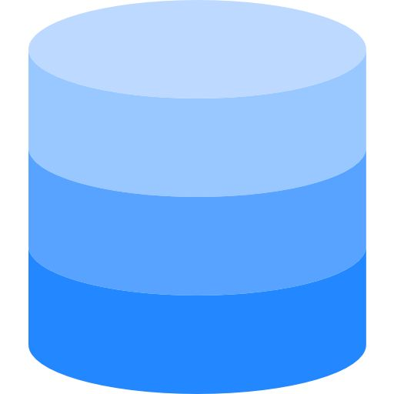


System architecture design
Order
Payment
Add to cart
Update profile
View Delivery Status
Customer
Customer
Add new products
Add recommended
Admin
Add popular products
Add delivery man
Registration & Authentication
Admin
Add, Delete & Update in Database
Delivery man
Update distance & location
Delivery man
Fig 1 System architecture of ‘bechakena’

Slide 7
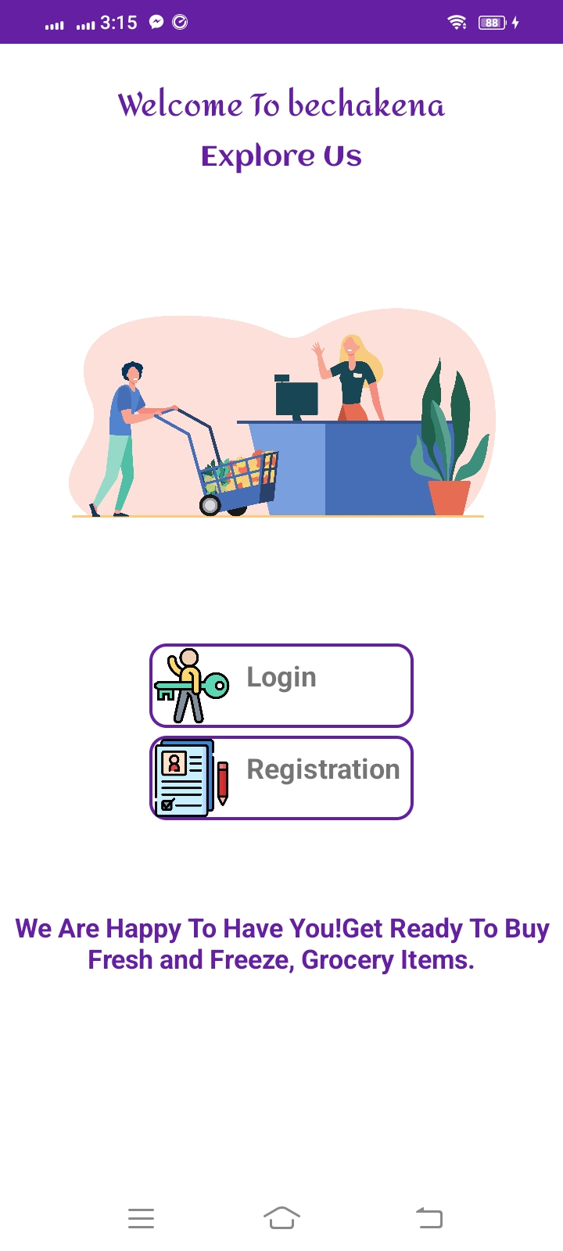
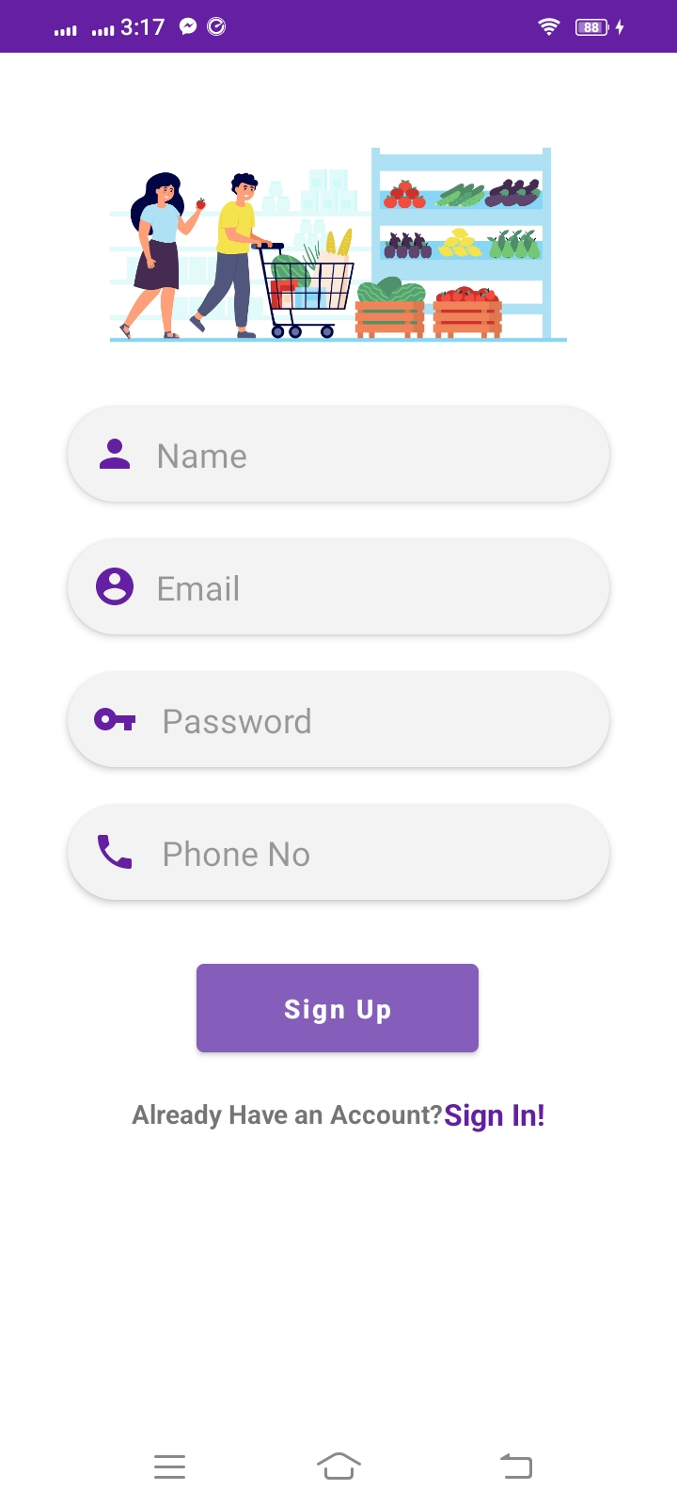
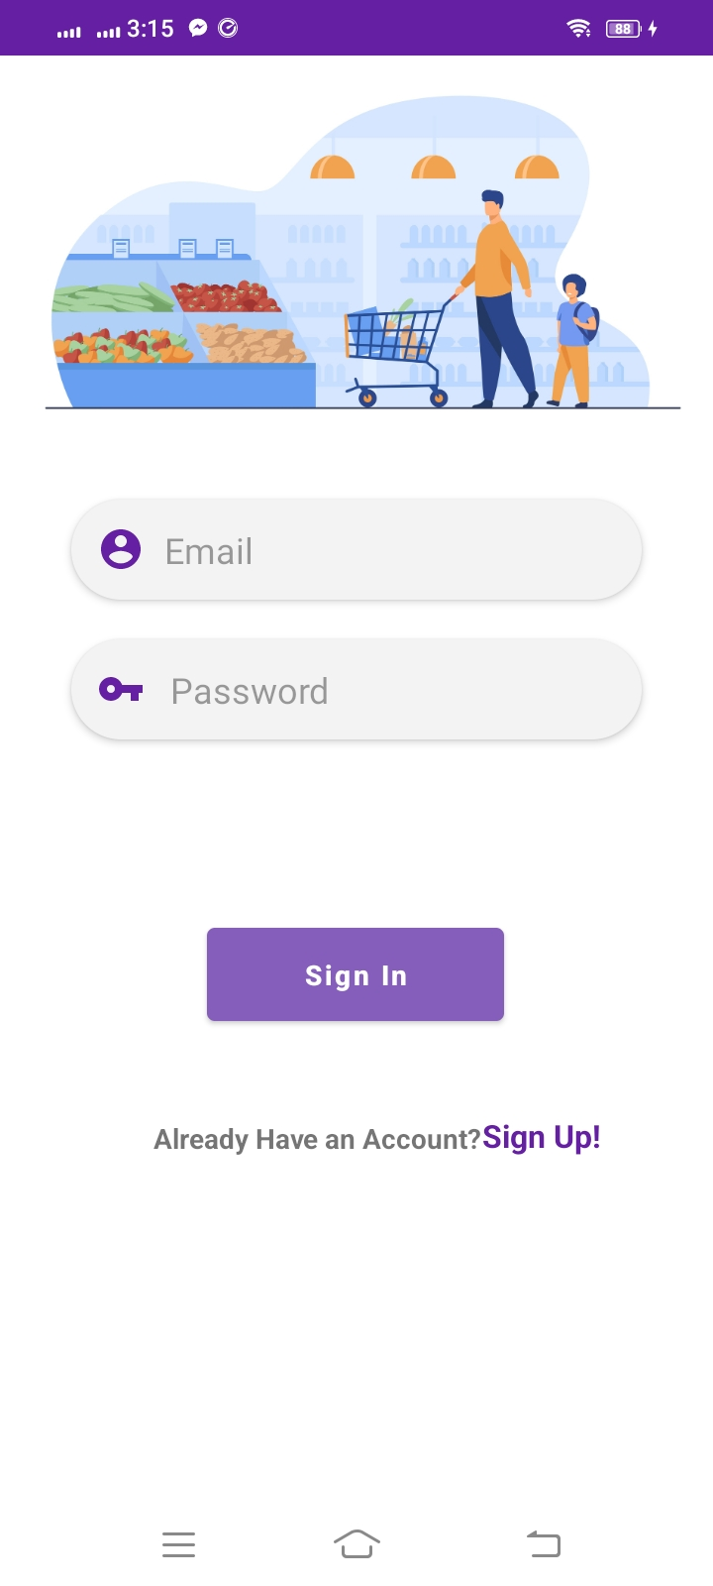
methodology
Now we see how our application will work from customers’ view-
This the splash screen of our application.
When customer will use this app, this screen will appear first
This is the login screen. If the customer has already an account then he/she will login here
This is the registration screen. If the customer has not an account then he/she will register first then login
Fig 1.1 Welcome screen
Fig 1.2 Registration screen
Fig 1.3 Login screen

Slide 8
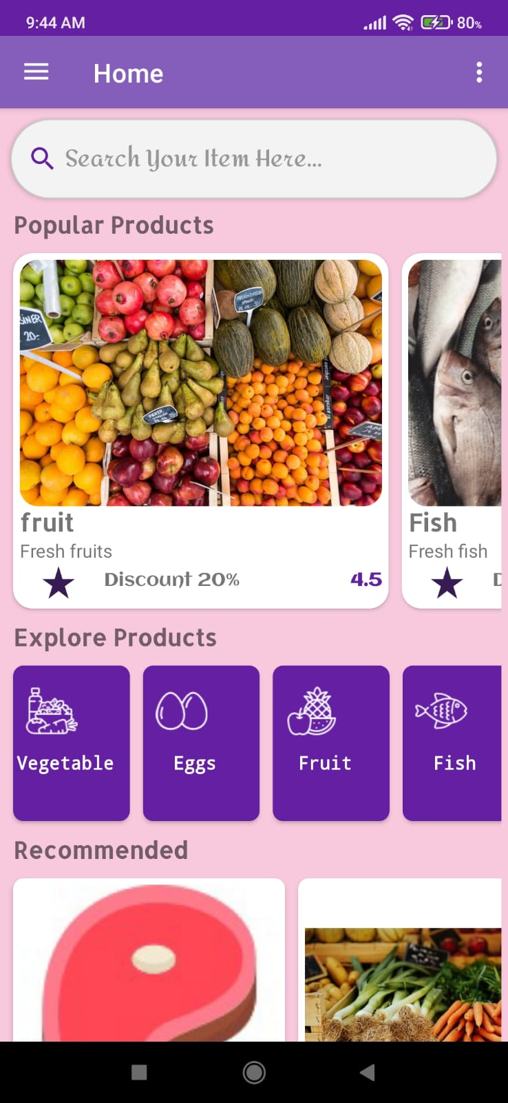
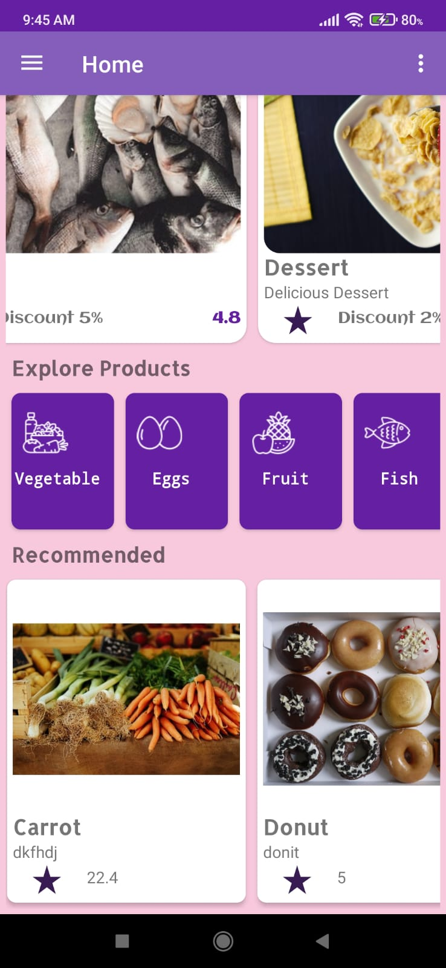
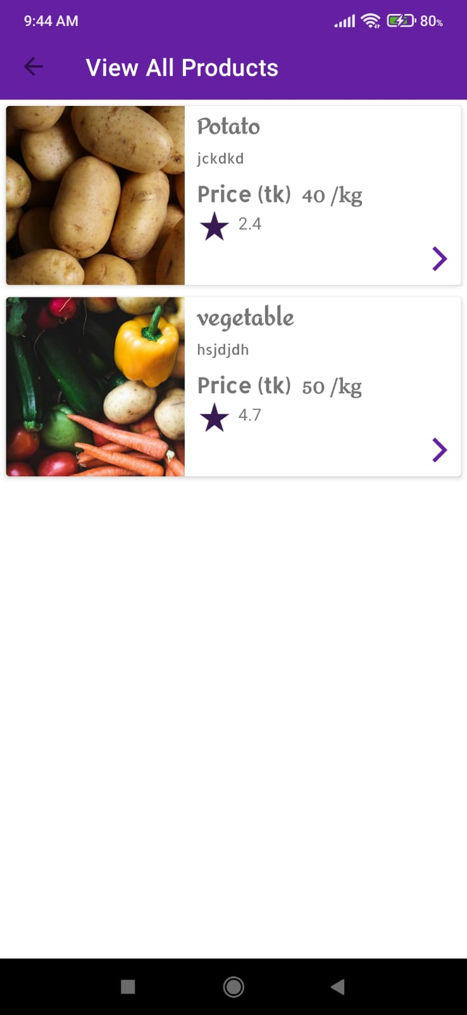
Methodology Cont’d
From customers’ view-
This the home screen of our application.
When customer will login successfully, this screen will appear first
This is the view all products screen. By tapping on any category, all the items under that category will appear here.
This is the full view of home screen. In the Explore products, all categories are added. In Recommended, we can see the recommended products added by admin.
Fig 1.4 Home screen
Fig 1.5 Home screen (Full view)
Fig 1.6 View All products screen

Slide 9
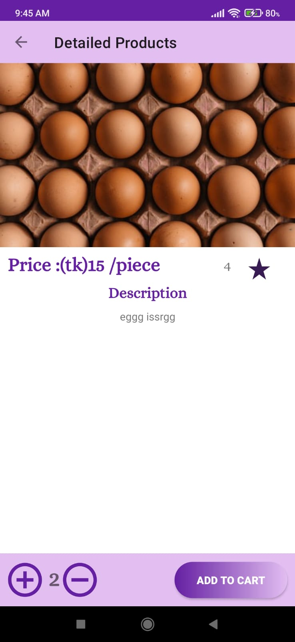
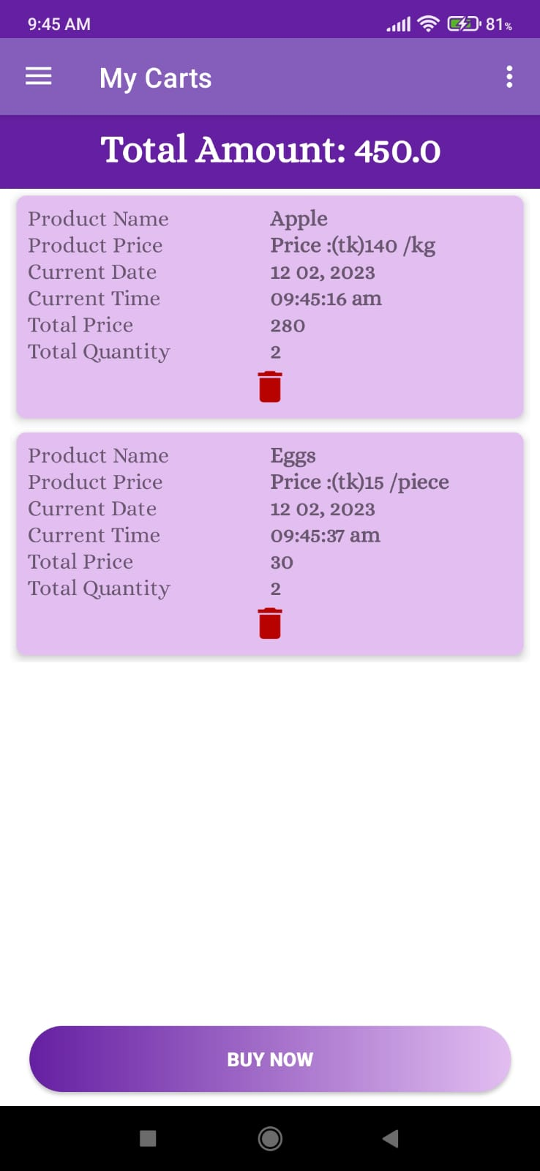
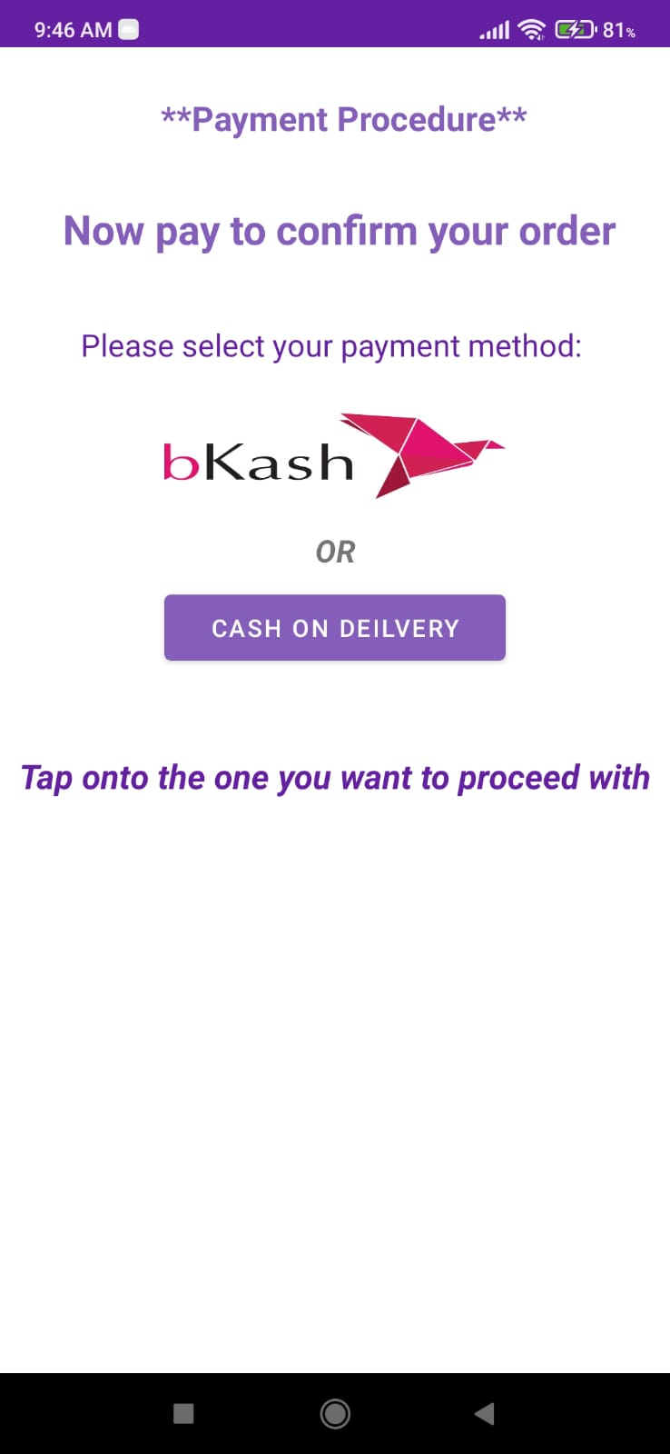
Methodology Cont’d
From customers’ view-
This the detailed screen of the product. Here we can add this product in our cart and increase and decrease the quantity using +, - button.
This is the payment screen. Customer can pay both in offline and online.
This is My cart screen. Here Customer can seen the products and also remove from cart and then buy them.
Fig 1.7 Detailed Product screen
Fig 1.8 My carts screen
Fig 1.9 Payment screen

Slide 10
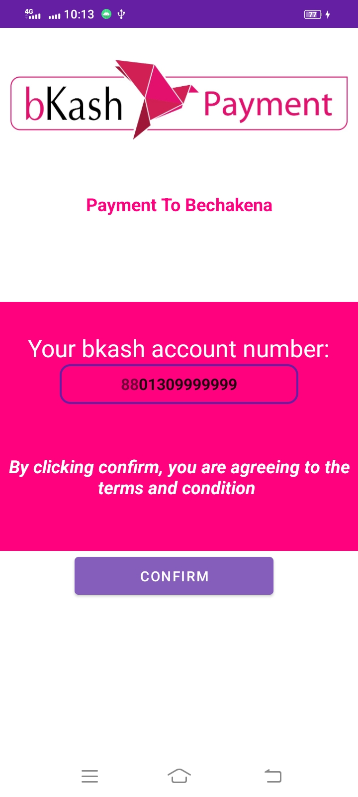
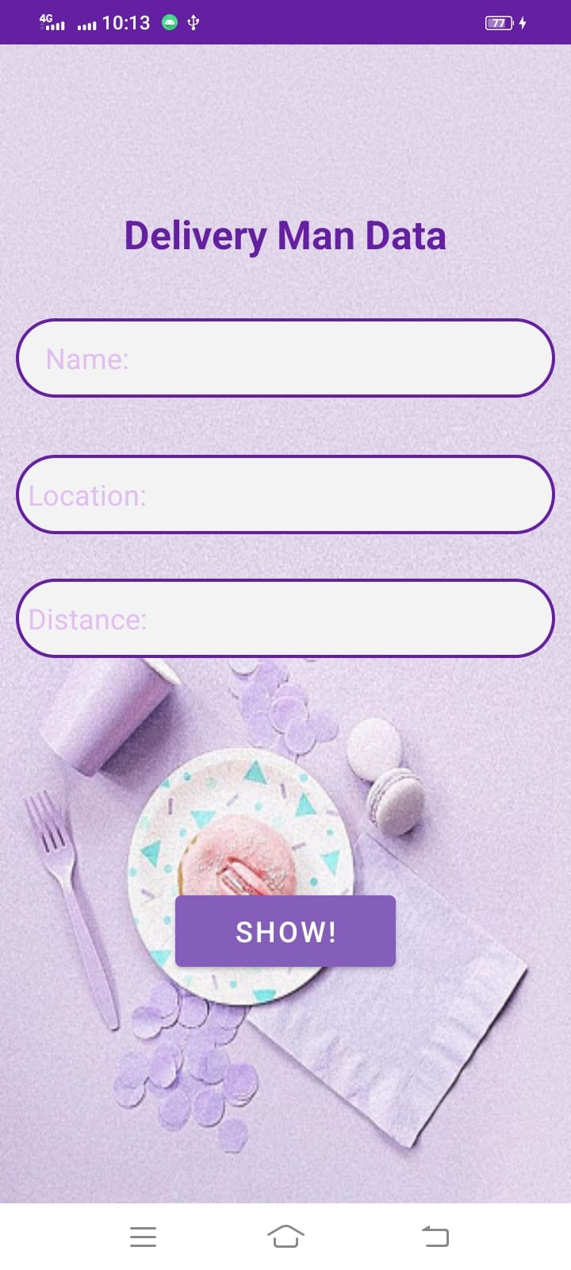
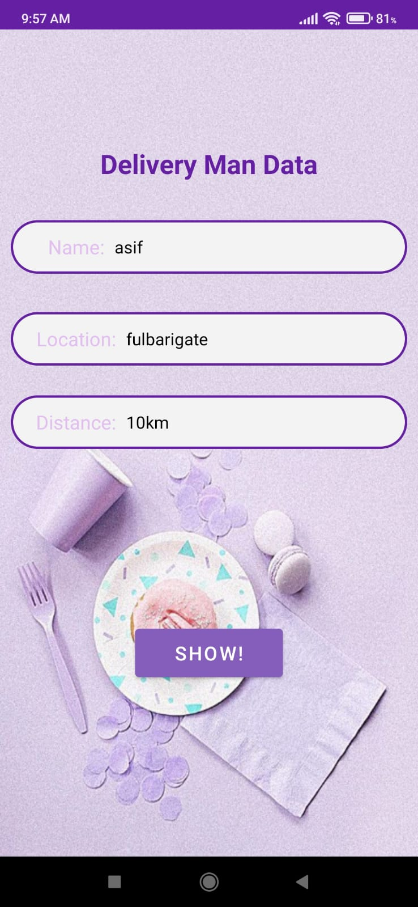
Methodology Cont’d
From customers’ view-
If the customer select bkash method, then this screen will appear. Here customer has to enter the number with which he/she has registered. If the number matches then it will go to the next screen (Delivery Man Data)
This is the payment screen. Customer can pay both in offline and online. After clicking show, information of delivery man will appear.
If the customer see cash on delivery then also this screen will appear. Here customer will show the details of the delivery man.
Fig 1.10 Bkash payment screen
Fig 1.11 Delivery man view screen
Fig 1.12 Delivery man view screen

Slide 11
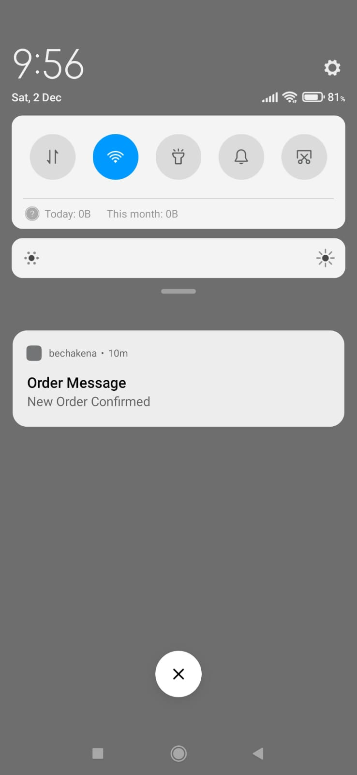
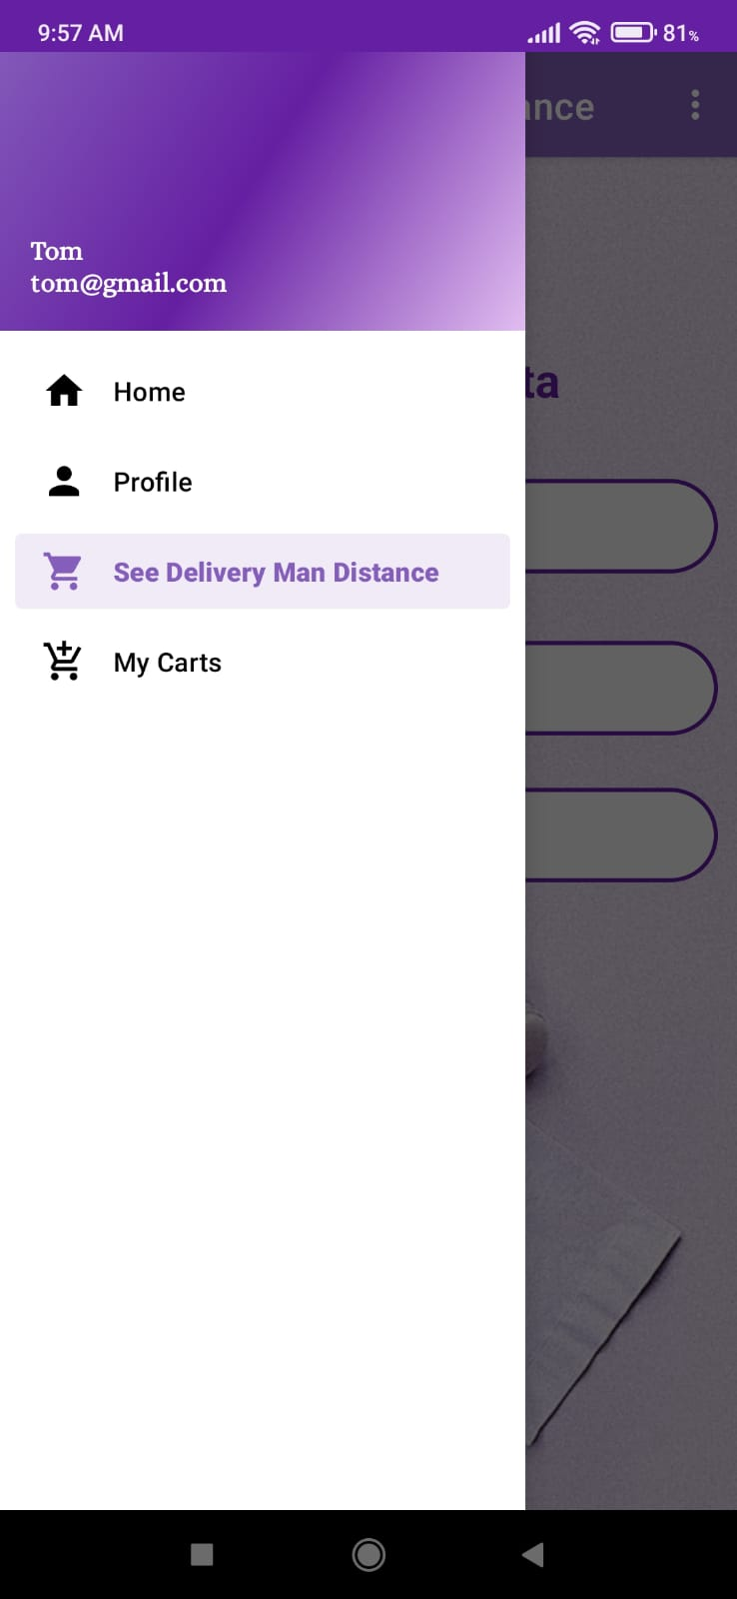
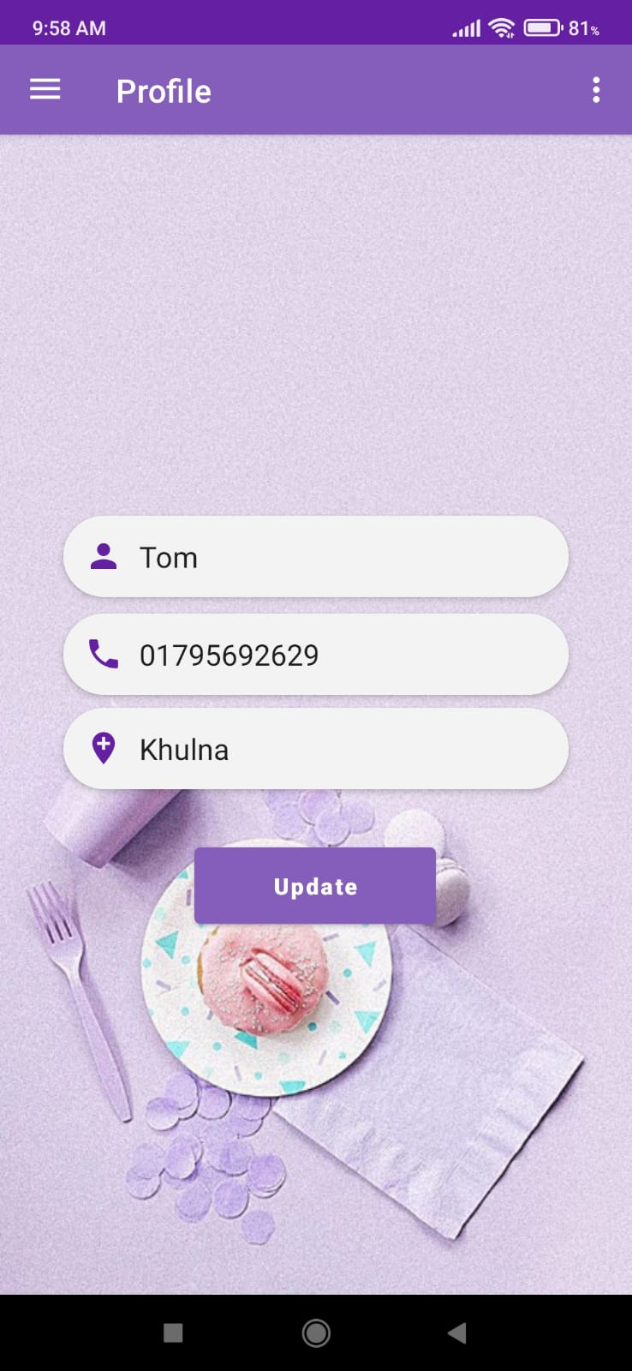
Methodology Cont’d
From customers’ view-
This notification will appear when a new customer confirms a order.
In the profile segment, customer can update name, phone number and address. Customer can also upload a profile picture.
This is the navigation drawer.
Fig 1.13 Received Order message
Fig 1.14 Navigation drawer
Fig 1.15 Update profile screen

Slide 12
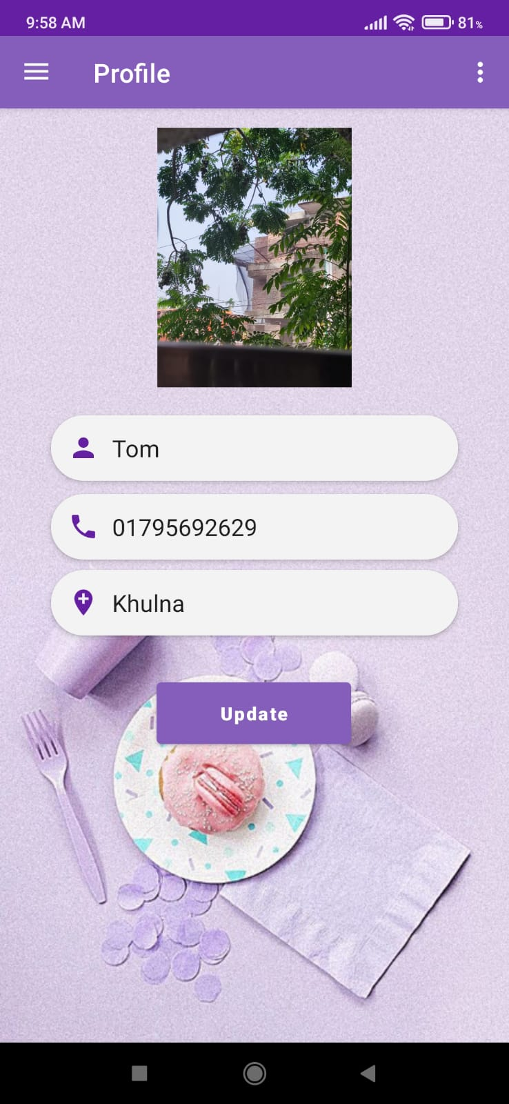
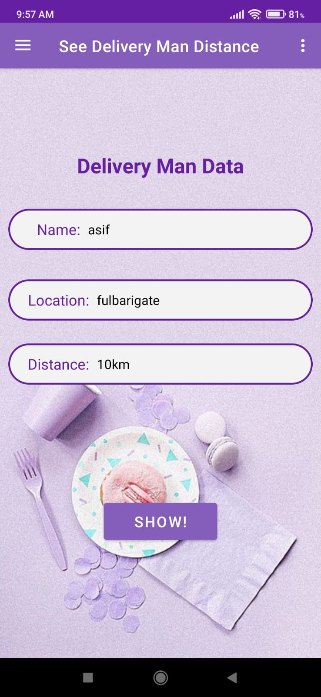
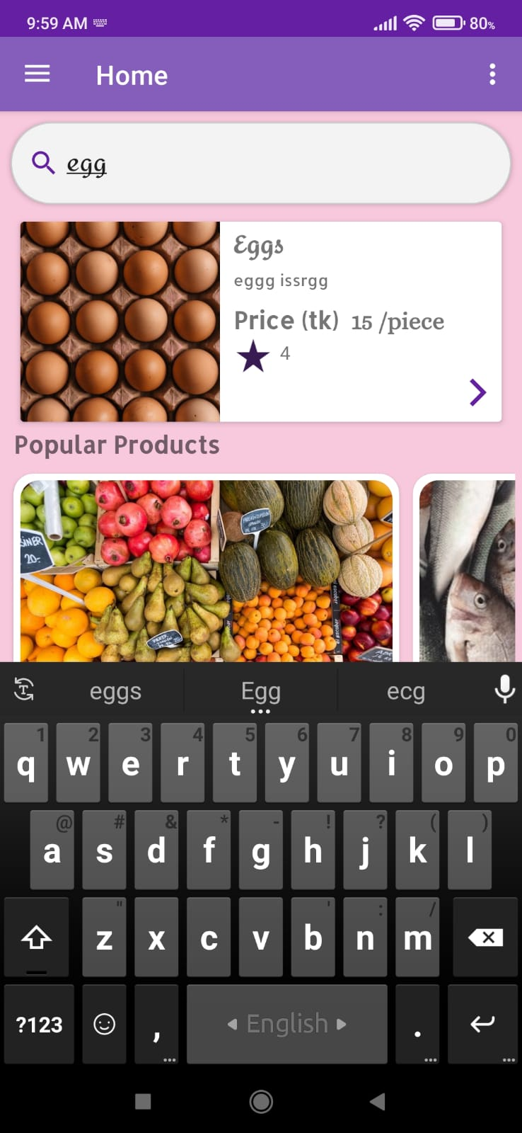
Methodology Cont’d
From customers’ view-
After uploading a profile picture, we can update the information.
In the search bar, customer can search for a specific product, then all the products related to that name will appear.
In the See Delivery Man Distance segment, customer can again see the current status of the delivery man.
Fig 1.16 Update profile screen
Fig 1.17 See Delivery man data screen
Fig 1.18 Searching product screen

Slide 13
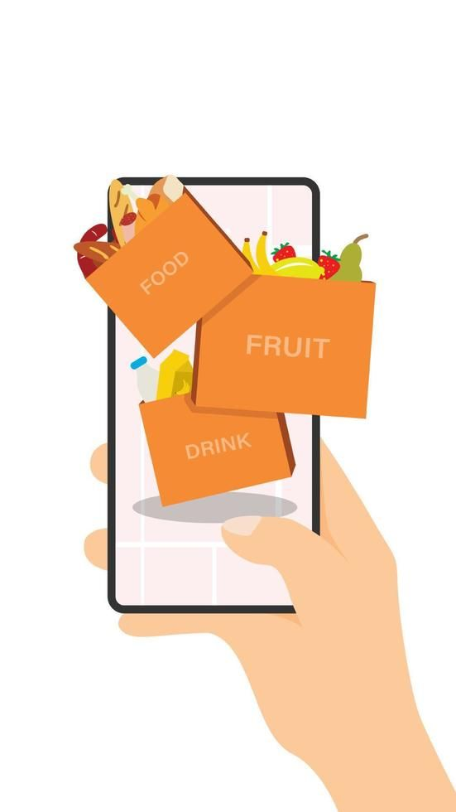
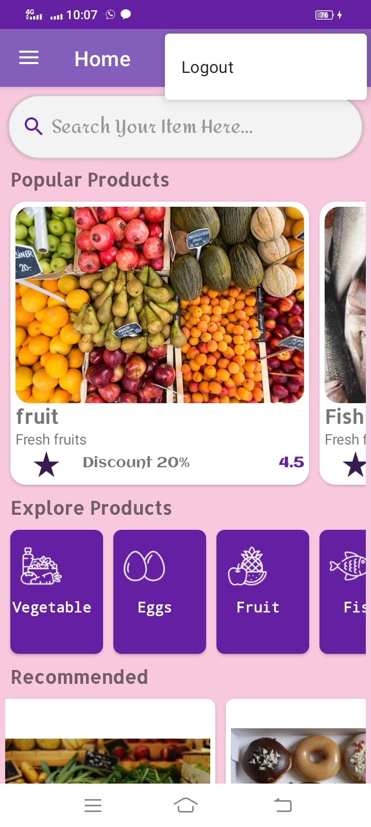
Methodology Cont’d
From customers’ view-
By using this menu, customer can logout from the current account.
Fig 1.19 Home screen with logout option

Slide 14
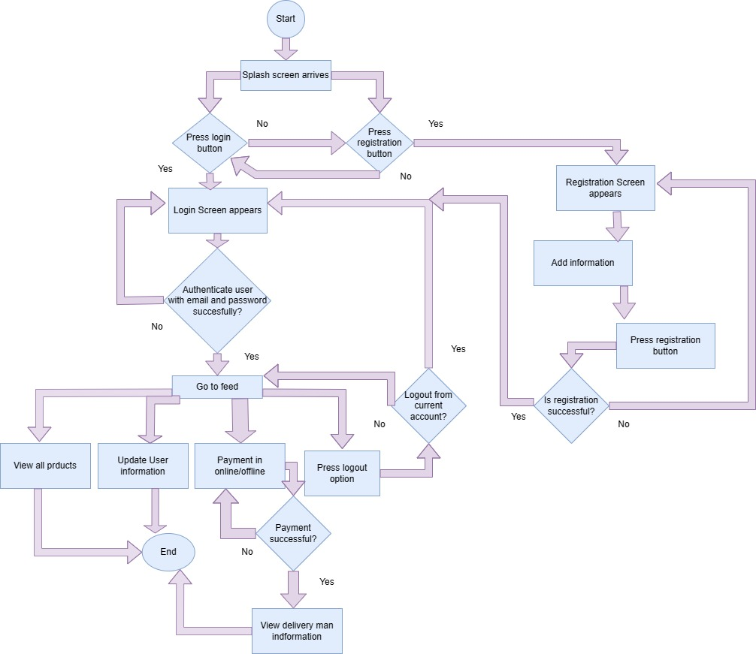
Methodology Cont’d
Flow chart from customers’ view:
This is the detailed flowchart from customers’ view. Here every step is included. That means the sequence of activities is shown here.
Fig 1.20 Flow chart for customer

Slide 15

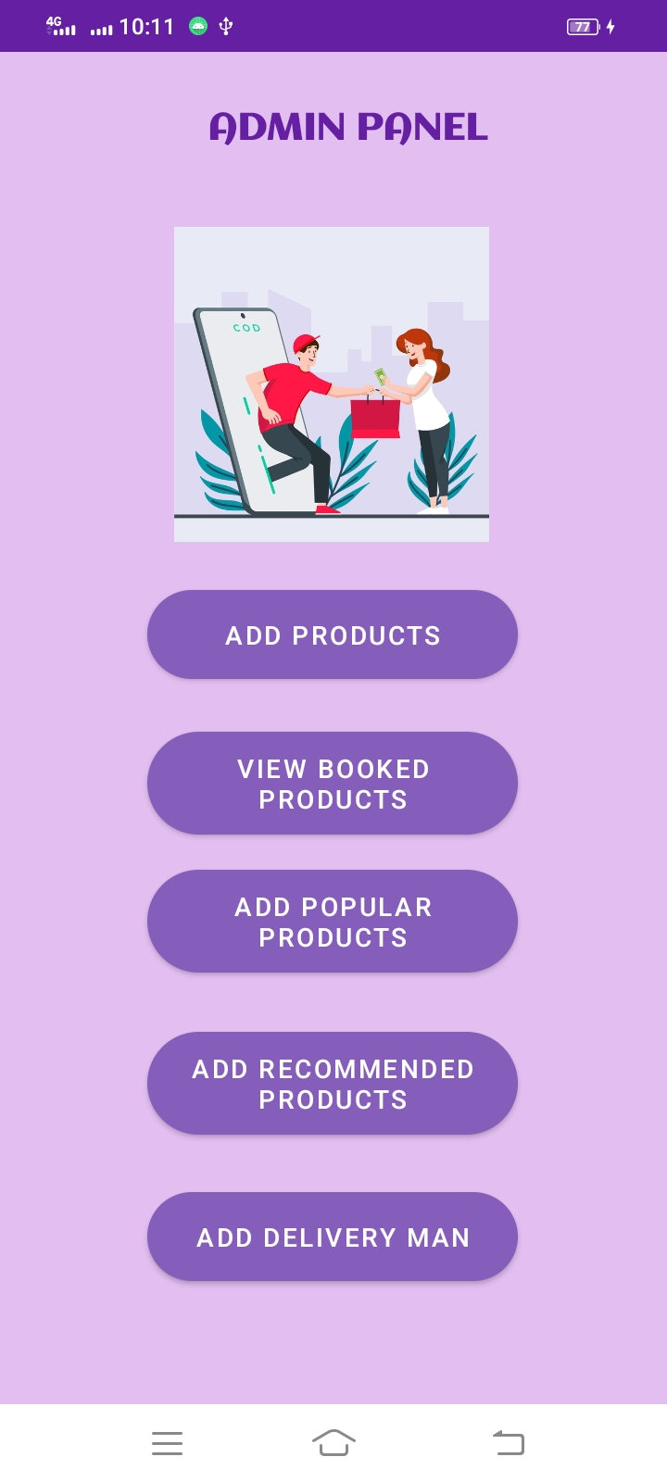
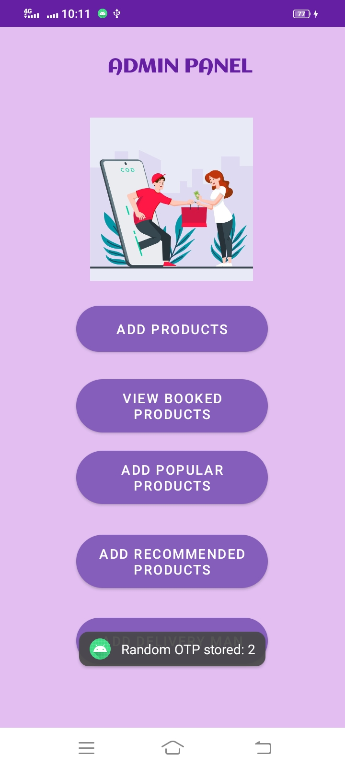
Methodology Cont’d
Now we see how our application will work from admin’s view-
This the admin login screen. Admin will login with specific email and password.
By pressing add delivery man, a delivery man will be randomly selected and assigned to the customer.
This is admin panel.
Fig 2.1 Admin login screen
Fig 2.2 Admin panel screen
Fig 2.3 Admin Panel (after adding delivery man)

Slide 16
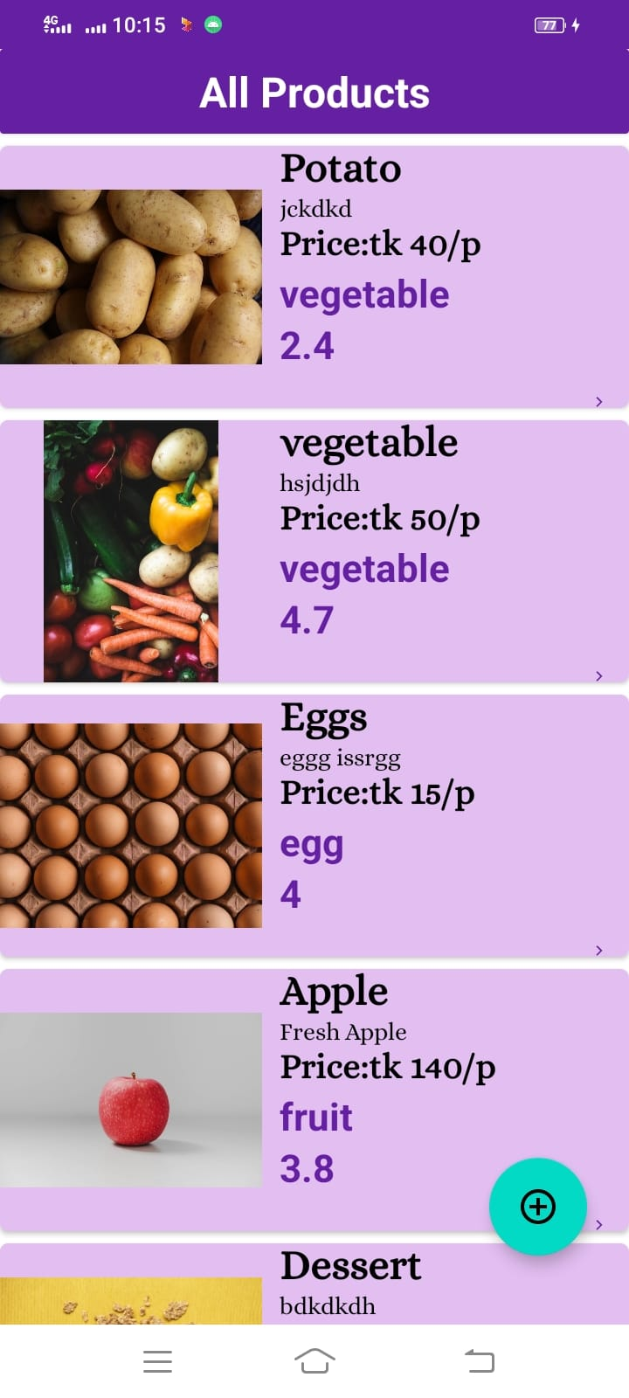
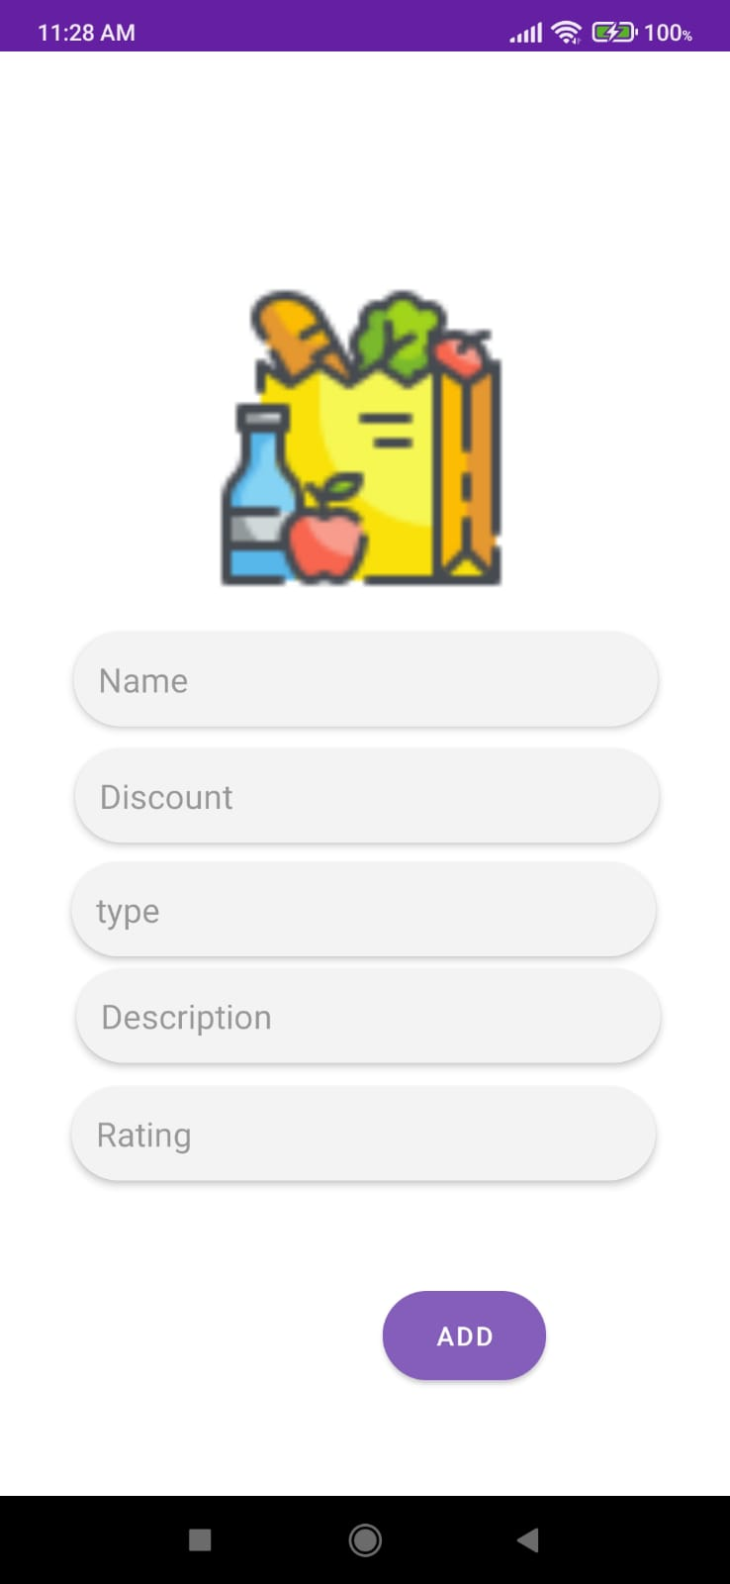
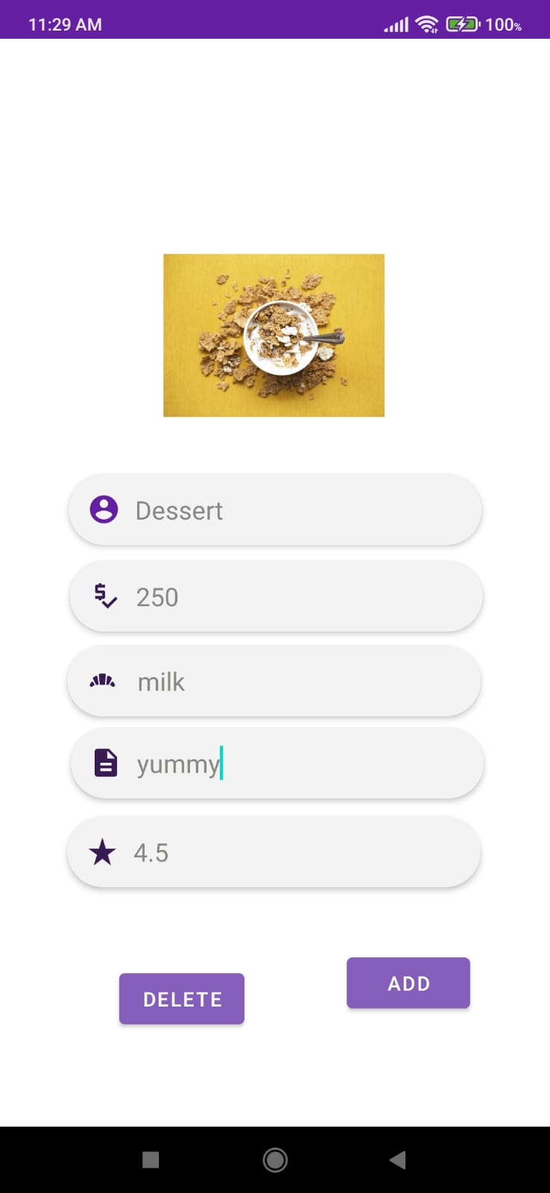
Methodology Cont’d
From admin’s view-
Then by selecting add products, screen like will appear. Admin can add new products here by clicking the + button.
Admin can also edit and delete the added products. If Add is pressed then the information will be updated. If Delete is pressed then the information will be deleted.
Admin can add new products here.
Fig 2.4 All Products screen (admin)
Fig 2.5 Add New products screen
Fig 2.6 Update available product screen

Slide 17
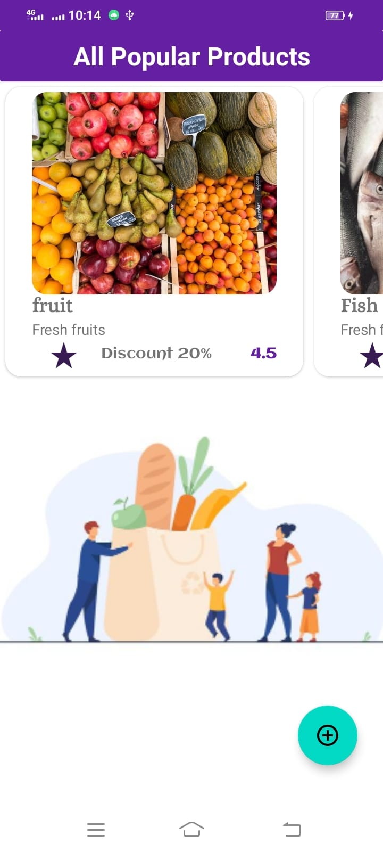
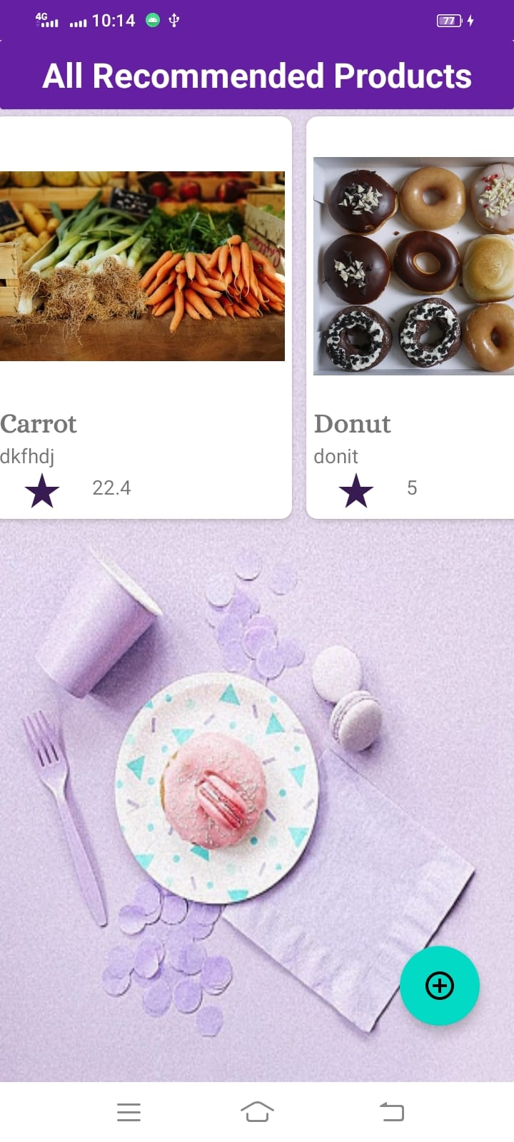
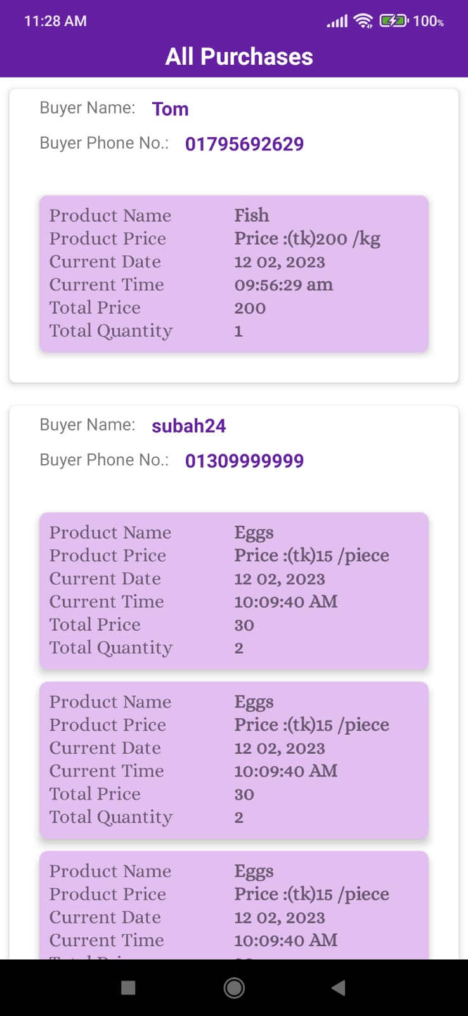
Methodology Cont’d
From admin’s view-
Here all the popular products added by admin will be shown. In the previous way, admin can add, update and delete popular products also.
Here admin can see the purchase requests of the customers with their name and phone number.
Here admin can see the all recommended products added by him. Admin can add, update or delete the recommended products also.
Fig 2.7 All popular products screen
Fig 2.8 All recommended products screen
Fig 2.9 View all purchase request screen

Slide 18
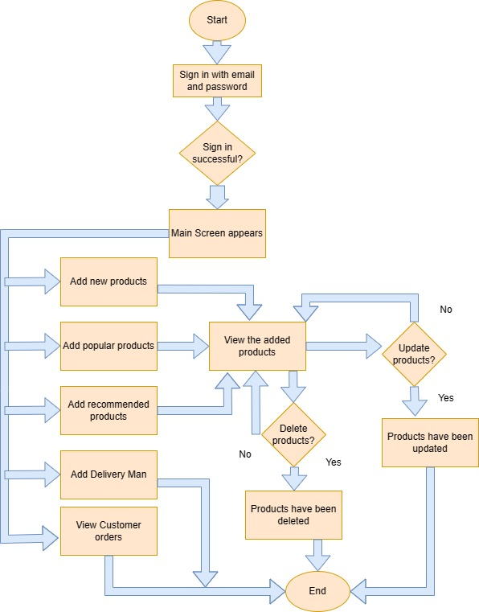
Methodology Cont’d
Flow chart from admin’s view:
This is the detailed flowchart from admin’s view. Here every step is included. That means the sequence of activities is shown here.
Fig 2.10 Flow chart for admin

Slide 19
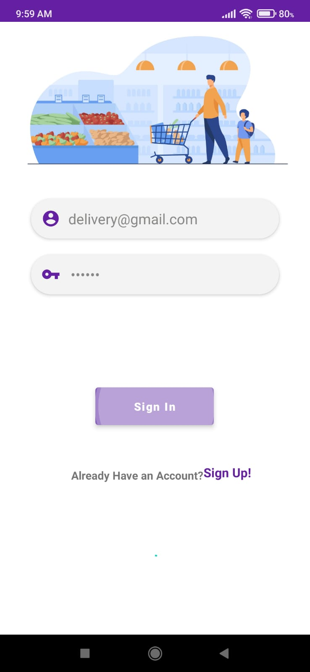
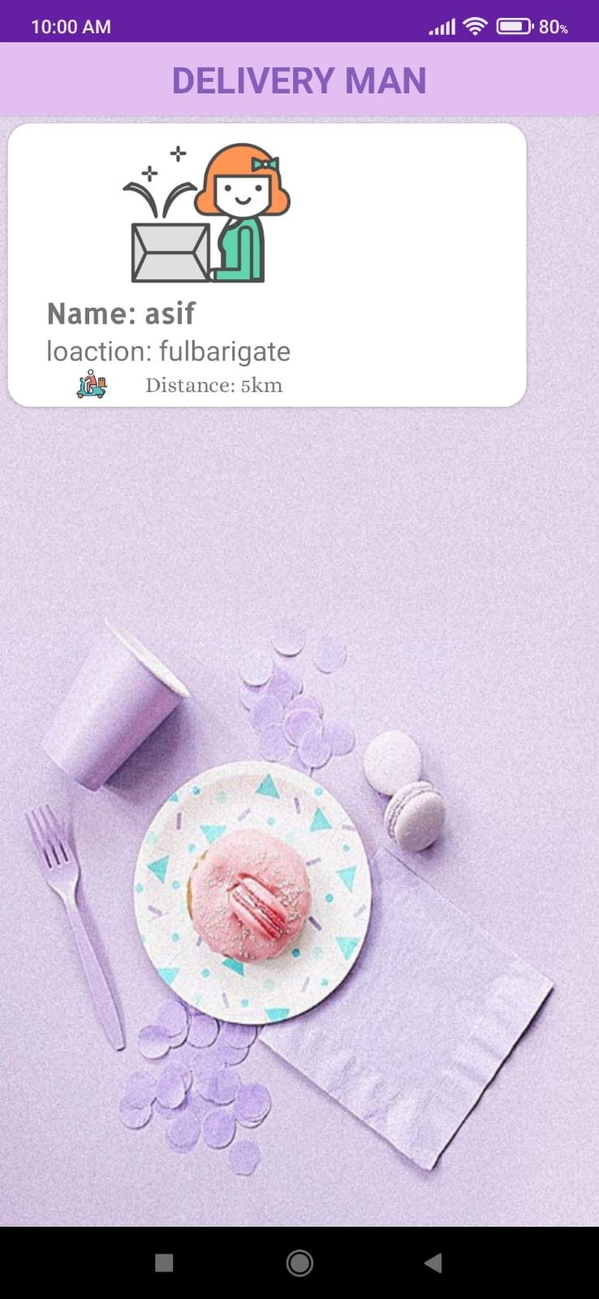
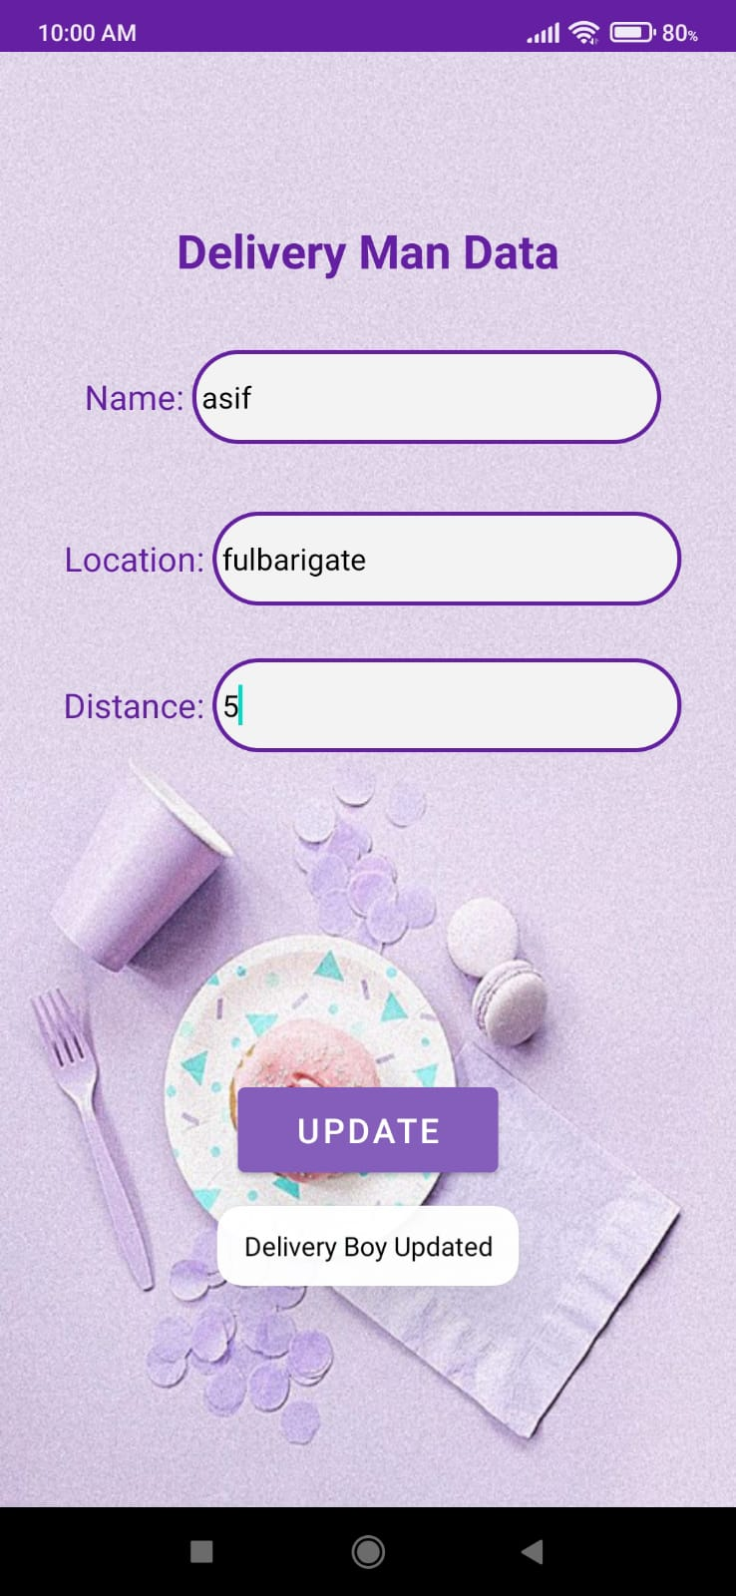
Methodology Cont’d
Now we see how our application will work from delivery man’s view-
This the delivery man login screen. He will login with specific email and password.
Now the delivery man can update his distance and location. This will be updated in firebase also and the user will see the updated information.
Here the delivery man will see the assigned delivery man. If he is assigned then his information will be shown.
Fig 3.1 Delivery man login screen
Fig 3.2 See assigned delivery man screen
Fig 3.3 Update screen (delivery man)

Slide 20
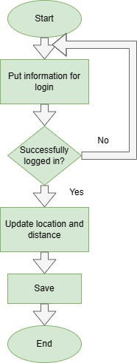
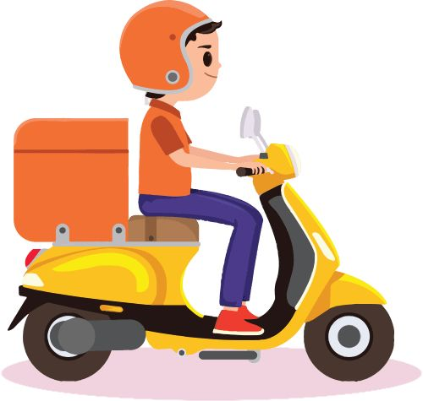
Methodology Cont’d
Flow chart from admin’s view:
This is the detailed flowchart from delivery man’s view. Here every step is included. That means the sequence of activities is shown here.
Fig 3.4 Flow chart for delivery man

Slide 21

Important features
View Products category wise
View Discounted products
Add to Cart
Pay for products (offline/online)
Update user profile
View delivery status
Get the fresh new grocery items

Slide 22
Challenges faced
Network Issues
Android Studio Dependency Problem
Firebase Version
Synchronization problem between our app and firebase
Android Studio Installed Version

Slide 23
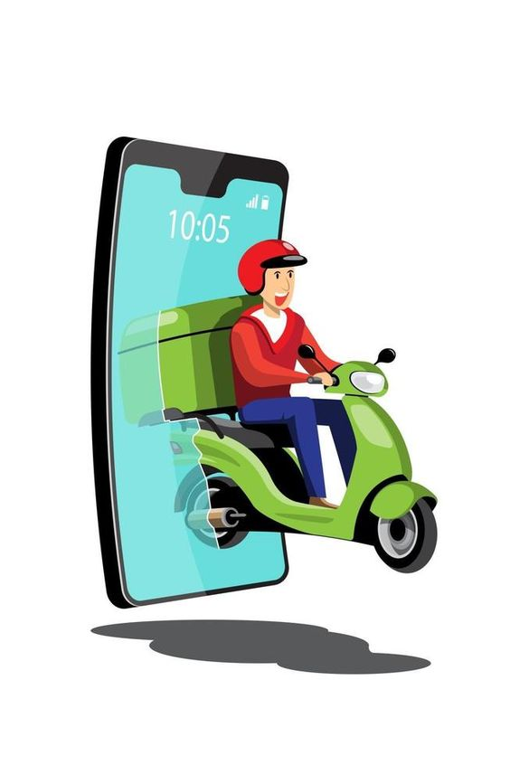
Future plan
Try to add the features of google map services
Using google map, delivery man will see the user’s location route
Try to add a feature like when delivery man completes delivery, a notification will be sent to admin
Try to add a chatbot with which customers can ask questions and chat with the chatbot
Try to add voice ordering

Slide 24

conclusion
bechakena is basically an online platform for shopping grocery items. It has the following specialties-
It is an android application with which customers can order daily grocery items.
We often have to go to outside for buying grocery items. But this app saves both time and energy.
Customers don’t have to go to outside. They can buy their products at home and get home delivery service.
Also our application is very useful for aged people. They can buy grocery items staying at home.
Thus, our application solves the problem.

Slide 25
Thank you everyone
Special thanks to our supervisor mam for her tremendous support and amazing ideas

